Slide 1
Why Gun Control is effective.
Ali Awari – aka87

Slide 2
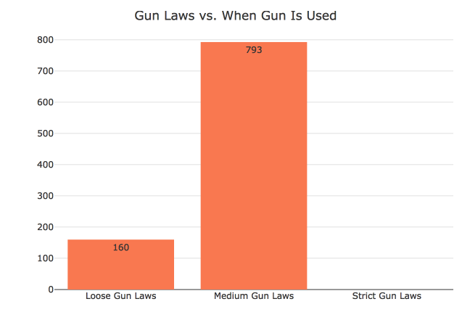
Gun Law Level Versus Guns Use
Things To Note:
Strict Gun Laws have shown to be effective in limiting the amount of gun use to zero in this dataset.

Slide 3
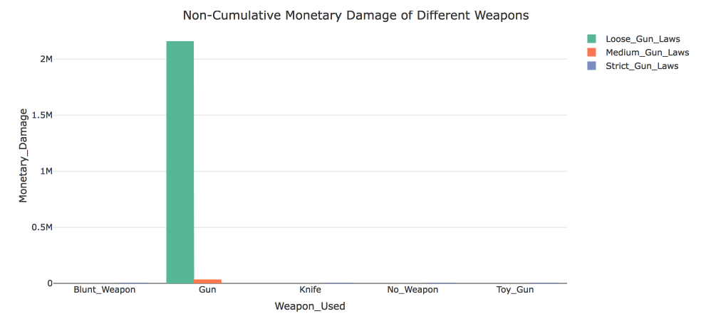
Monetary Damage of Weapons
Cumulatively, Loose Gun Laws create the greatest amount of monetary damage at: $13,185,874.28
Medium Gun Laws: $1,486,873.13
Strict Gun Laws: $23,482.97
When gun laws are loose, the amount of monetary damage guns cause is so high, it dwarfs all other damages caused by different types of weapons.

Slide 4
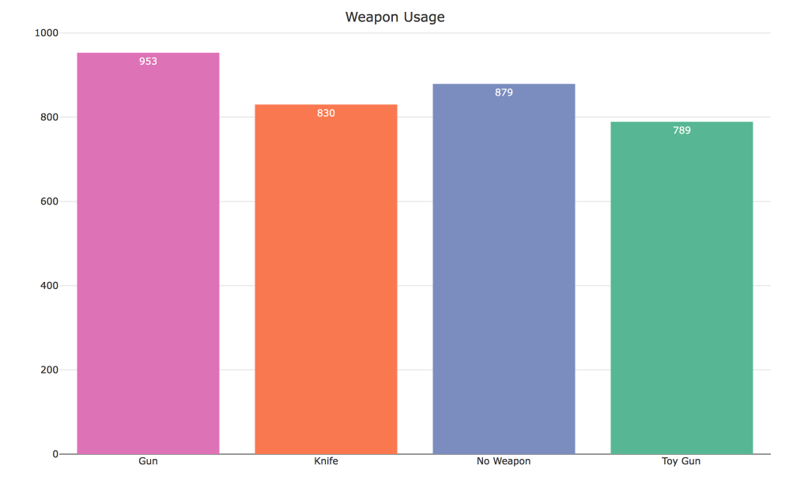
The Usage of Different Weapons
Guns are the highest used weapon
Guns only exist in places with Medium Gun Laws, and Loose Gun Laws

Slide 5
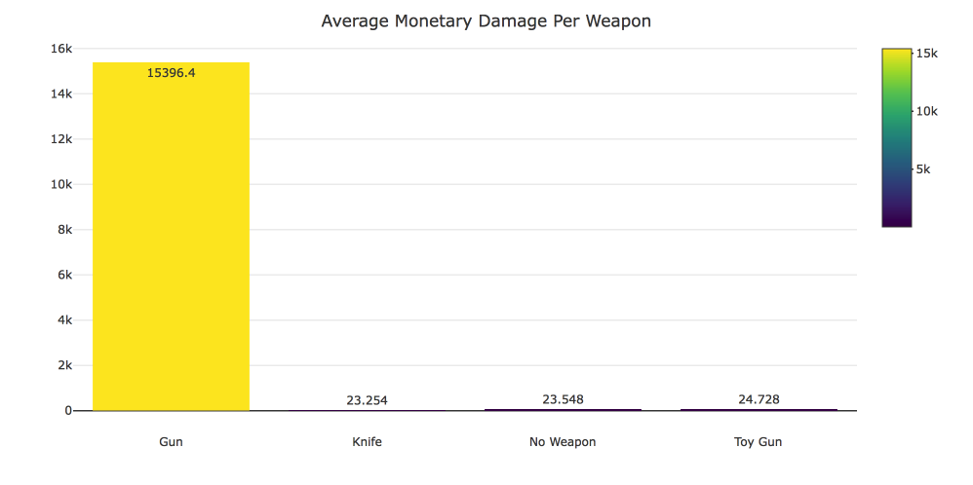
Average Monetary Damage Per Weapon
The difference between the average amount of monetary damage caused by weapons in this data set clearly shows, how devastating guns are.
215 times more than all other weapons combined!

Slide 6
Conclusion
Guns cause the greatest amount of cumulative Monetary Damage.
Guns are used on average, to do larger amounts of damage.
Guns are used more often than any other weapon
Strict Gun Laws, according to this dataset limit the use guns to 0.
Strict Gun Laws are effective in limiting the amount of damages that guns cause.

